Slide 1
Concurrency Control

Slide 2
Concurrency control
Concurrency control is the procedure in DBMS for managing simultaneous operations without conflicting with each another.
Concurrent access is quite easy if all users are just reading data. There is no way they can interfere with one another.
Though for any practical database, would have a mix of reading and WRITE operations and hence the concurrency is a challenge.

Slide 3
Concurrency control is used to address such conflicts which mostly occur with a multi-user system.
It helps you to make sure that database transactions are performed concurrently without violating the data integrity of respective databases.
Therefore, concurrency control is a most important element for the proper functioning of a system where two or multiple database transactions that require access to the same data, are executed simultaneously.

Slide 4
Why use Concurrency method?
To apply Isolation through mutual exclusion between conflicting transactions
To resolve read-write and write-write conflict issues
To preserve database consistency through constantly preserving execution obstructions
The system needs to control the interaction among the concurrent transactions. This control is achieved using concurrent-control schemes.
Concurrency control helps to ensure serializability

Slide 5
Concurrency Control Protocols
Lock-Based Protocols
Two Phase
Timestamp-Based Protocols
Validation-Based Protocols

Slide 6
Lock-Based Protocols
A lock is a mechanism to control concurrent access to a data item
Data items can be locked in two modes
1. Exclusive (X) mode: read/write
2. Shared (S) mode: read
Lock requests are made to concurrency-control manager. Transaction can proceed only after request is granted.

Slide 7

Lock-Based Protocols (Cont.)
Lock-compatibility matrix
A transaction may be granted a lock on an item if the requested lock is compatible with locks already held on the item by other transactions
Any number of transactions can hold shared locks on an item
No other transaction may hold any lock on the item if any transaction holds an exclusive lock on the item
If a lock cannot be granted, the requesting transaction must wait till all incompatible locks held by other transactions have been released.

Slide 8
Locking Protocol
Simple Locking Protocol
Two Phase Locking (2PL) Protocol

Slide 9
Lock-Based Protocols (Cont.)
T1 transfer 100 rupees from A to B
lock-X(A);
read (A);
A=A-100;
Write(A)
unlock(A);
lock-X(B);
read (B);
B=B+100;
Write(B);
unlock(B);
T2 Display A+B details
lock-S(A);
read (A);
unlock(A);
lock-S(B);
read (B);
unlock(B);
display(A+B)

Slide 10
Lock-Based Protocols (Cont.)
Example
Locking as above is not sufficient to guarantee serializability
  If A and B get updated between the read of A and B, the displayed sum would be wrong.
A locking protocol is a set of rules followed by all transactions while requesting and releasing locks. Locking protocols restrict the set of possible schedules.

Slide 11
Starvation
Starvation is the situation when a transaction needs to wait for an indefinite period to acquire a lock.
Following are the reasons for Starvation:
When waiting scheme for locked items is not properly managed
In the case of resource leak
The same transaction is selected as a victim repeatedly

Slide 12

Pitfalls of Lock-Based Protocols
Deadlock
Neither T₃ nor T₄ can make progress — executing lock-S(B) causes T₄ to wait for T₃ to release its lock on B, while executing lock-X(A) causes T₃ to wait for T₄ to release its lock on A.
Deadlock refers to a specific situation where two or more processes are waiting for each other to release a resource or more than two processes are waiting for the resource in a circular chain.

Slide 13
Pitfalls of Lock-Based Protocols (Cont.)
Starvation
  A transaction may be waiting for an X-lock on an item, while a sequence of other transactions request and are granted an S-lock on the same item.
Concurrency control manager can be designed to prevent starvation.

Slide 14
Two Phase Locking Protocol
In the first phase, when the transaction begins to execute, it requires permission for the locks it needs.
The second part is where the transaction obtains all the locks. When a transaction releases its first lock, the third phase starts.
In this third phase, the transaction cannot demand any new locks. Instead, it only releases the acquired locks.

Slide 15
Two Phase Locking Protocol
Supports conflict serializability
Growing Phase: In this phase transaction may obtain locks but may not release any locks.
Shrinking Phase: In this phase, a transaction may release locks but not obtain any new lock
Transactions can be serialized in the order of their lock points (i.e. the points where transactions acquire their final locks).

Slide 16
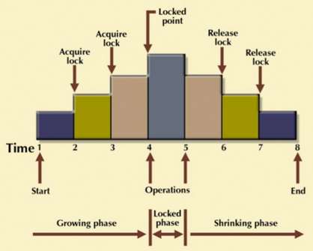
Two Phase Locking Protocol

Slide 17
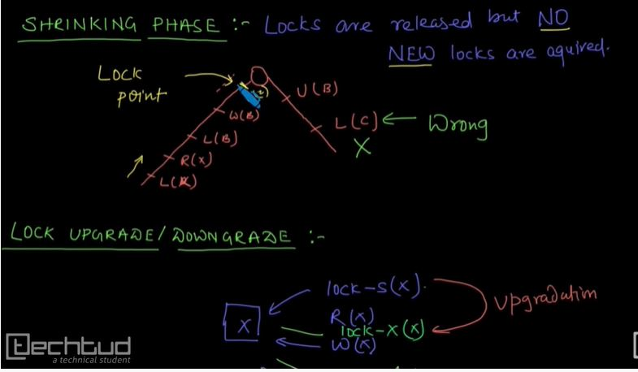

Slide 18
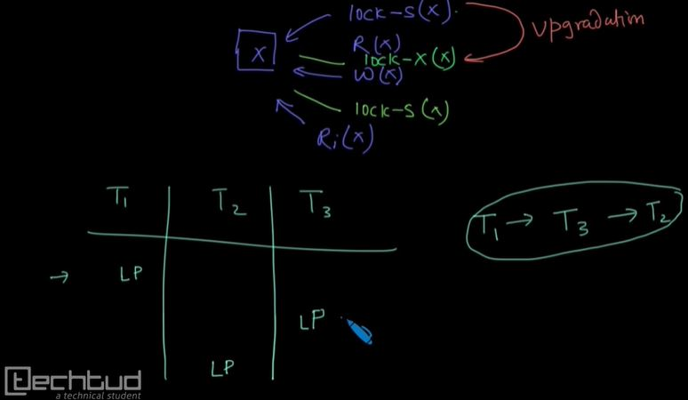

Slide 19
Strict Two-Phase Locking Method
Strict-Two phase locking system is almost similar to 2PL. The only difference is that Strict-2PL never releases a lock after using it. It holds all the locks until the commit point and releases all the locks at one go when the process is over.
Centralized 2PL
In Centralized 2 PL, a single site is responsible for lock management process. It has only one lock manager for the entire DBMS.

Slide 20
Timestamp based Concurrency Control
With each transaction T_{i} in the system, we associate a unique fixed timestamp, denoted by TS(T_{i}). This timestamp is assigned by the database system before the transaction T_{i} starts execution.
If a transaction T_{i} has been assigned timestamp TS(T_{i}), and a new transaction T_{j} enters the system, then TS(T_{i}) < TS(T_{j} ).

Slide 21
There are two simple methods for implementing this scheme:
1. Use the value of the system clock as the timestamp; that is, a transaction’s timestamp is equal to the value of the clock when the transaction enters the system.
2. Use a logical counter that is incremented after a new timestamp has been assigned; that is, a transaction’s timestamp is equal to the value of the counter

Slide 22
when the transaction enters the system.
The timestamps of the transactions determine the serializability order. Thus, if TS(T_{i}) < TS(T_{j} ), then the system must ensure that the produced schedule is equivalent to a serial schedule in which transaction T_{i} appears before transaction T_{j} .
To implement this scheme, we associate with each data item Q two timestamp values:
• W-timestamp(Q) denotes the largest timestamp of any transaction that executed write(Q) successfully.
• R-timestamp(Q) denotes the largest timestamp of any transaction that executed read(Q) successfully.

Slide 23
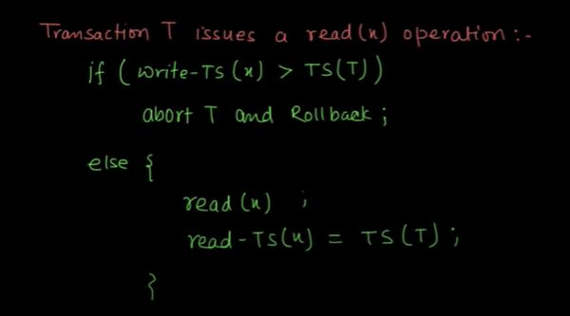
Suppose that transaction T_{i} issues read(x).

Slide 24
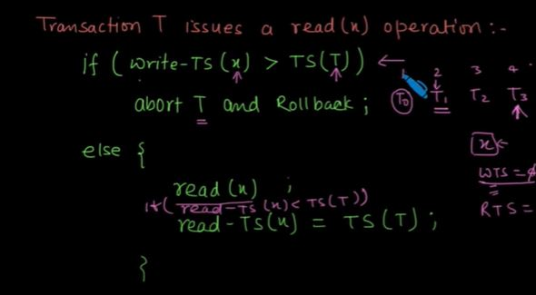

Slide 25
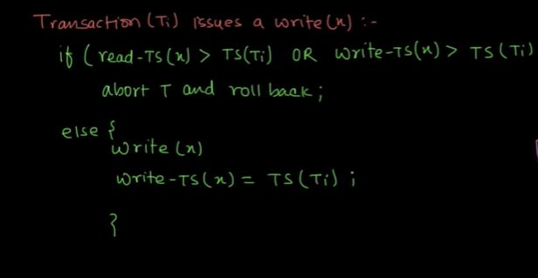
Suppose that transaction Ti issues write(X)

